Slide 1

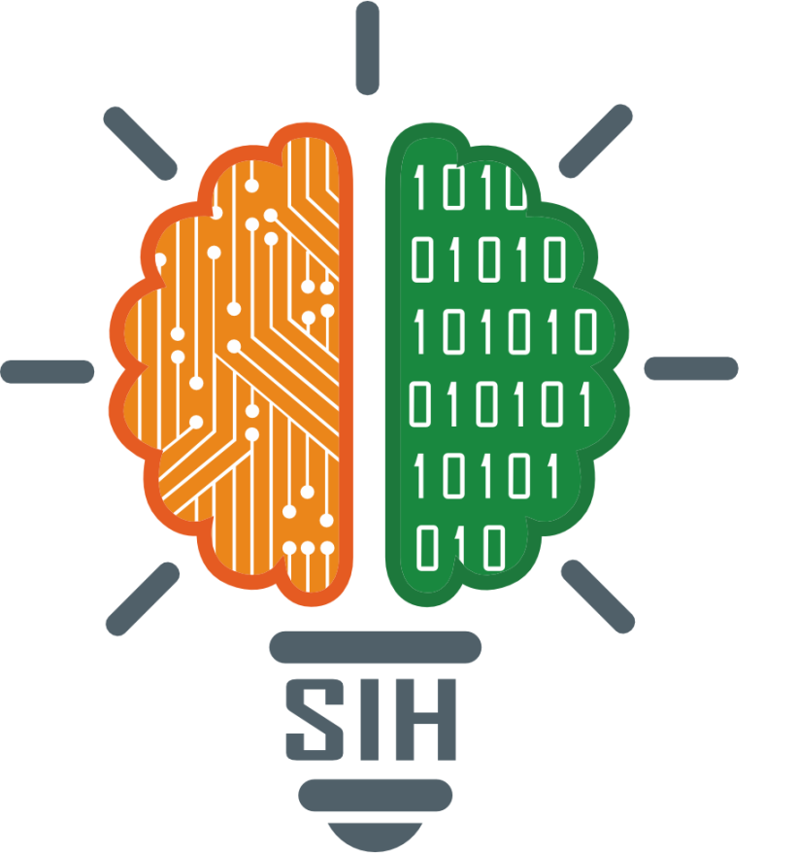
SMART INDIA HACKATHON 2024
Fingerprint Based Voting System
Problem Statement ID - SIH1588
Problem Statement Name - Student Innovation
Theme - Miscellaneous
PS Category- Software & Hardware
Team ID - 22304
Team Name - Brainy Bots

Slide 2

Fingerprint Based Voting System
Brainy
Bots
Proposed solution
The Fingerprint-Based Voting System is designed to enhance the electoral process by utilizing biometric technology to authenticate voters through their fingerprints.
The Fingerprint-Based Voting System address Voter Authentication, Enhanced Security and Real-Time Monitoring
Innovation and Uniqueness of the Solution is biometric integration with software tools to conduct electoral process transparently and avoid mal practices

Slide 3
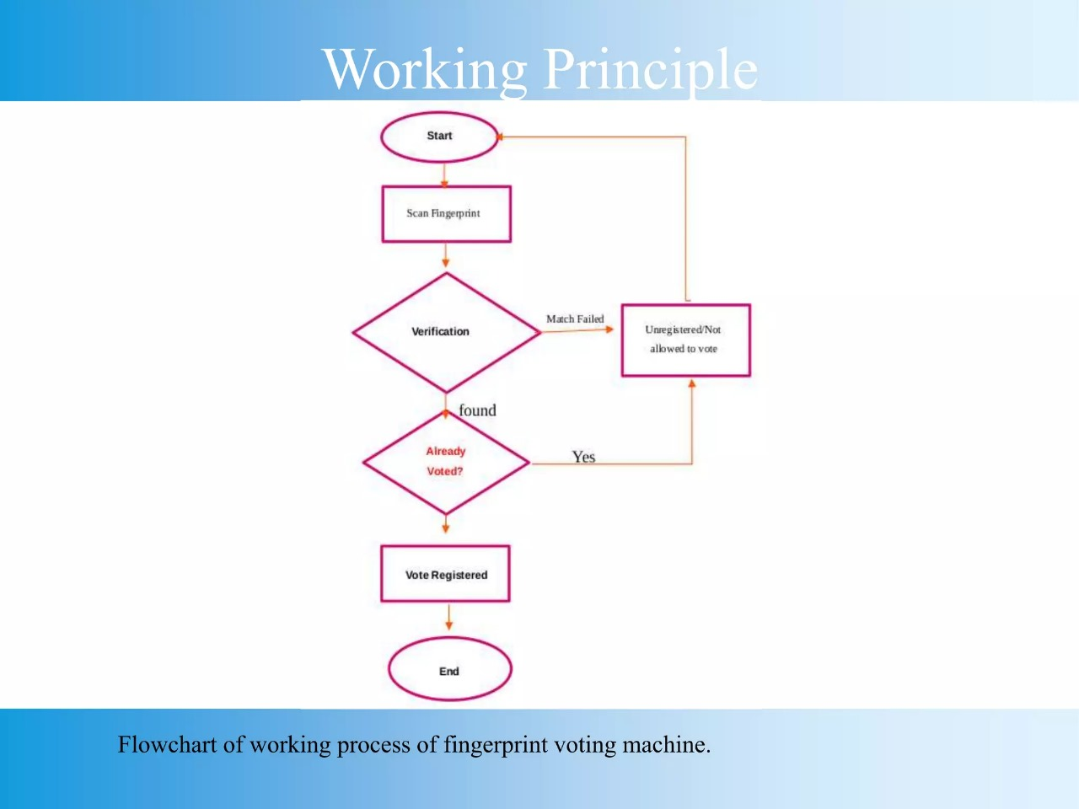
Brainy
Bots

Slide 4
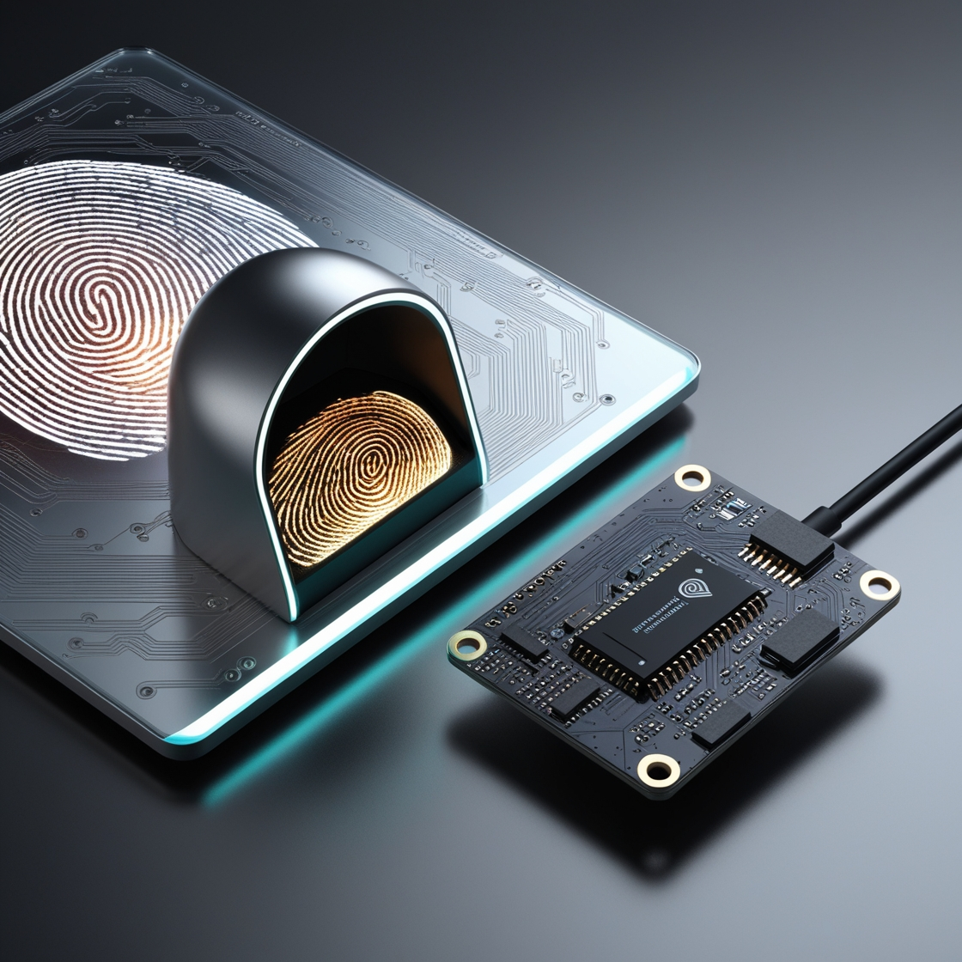

TECHNICAL APPROACH
Brainy
Bots
The fingerprint-based voting system is primarily a combination of both hardware and software components.
Hardware components :
1. Biometric Fingerprint Scanner,
2. Microcontroller Unit (MCU)
Software components :
1. User Interface ,
2. Database Management System
3. IOT Integration

Slide 5
FEASIBILITY AND VIABILITY
Brainy
Bots
1
Biometric Authentication , Existing system like Aadhar and people are technically good at phones etc. it is easy to adopt
Data Privacy and Security , Voter acceptance and Technological risks are key challenges
Robust data security measures ,it can also be controlled by reducing data anomalies, efficient technical equipment etc
2
3

Slide 6
IMPACT AND BENEFITS
Brainy
Bots
IMPACTS
BENEFITS
Enhanced Security
Increased Voter
Participation
Efficient Voting Process
Accuracy
Reliability
Accessibility
Transparency

Slide 7
RESEARCH AND REFERENCES
Brainy
Bots
RESEARCH
REFERENCES
1
Prototype Development for Swift Voting
1
IOT basic knowledge by Google search engine
2
2
Biometric authentication by social awareness
Authenticated voting system
3
3
Electronic voting system
Software skills like UI,DBMS

